Slide 1
Integration and Testing of Embedded firmware & Hardware
Module 4

Slide 2
Topics to Cover
Integration of Hardware and Firmware
Embedded System Development Environment-IDEs
Cross Compilers
Disassemblers
Decompilers
Simulators, Emulators and Debuggers.

Slide 3
Introduction
Integration and testing of embedded hardware and software is the immediate step following the embedded hardware and firmware development.
The final embedded hardware constitutes of a PCB with all necessary components affixed to it as per the original schematic diagram.
Embedded firmware represents the control algorithm and configuration data necessary to implement the product requirement on the product.
Embedded firmware will be in processor understandable machine code form.
Both embedded hardware and firmware should be independently tested to ensure the proper functioning.

Slide 4
Verifying hardware sections
Functioning of individual hardware sections can be verified by writing small utilities which checks the operations of the specified part.
The functionality of the firmware part can be checked by simulator environment provided by the embedded firmware development tools IDE.
By simulating the firmware, the register details, memory contents and status of flags can be easily monitored and gives a idea about what happens inside the processor.

Slide 5
Integration of Hardware & Firmware
Deals with embedding of firmware into the target hardware board
It’s the process of embedding intelligence to the product
If the processors internal memory has enough space to accommodate the firmware, it will be loaded there, else additional EPROM/Flash chips are used for saving the firmware.

Slide 6
Integration of Hardware & Firmware
There are different techniques for embedding firmware to hardware
Out-of-Circuit Programming
In System Programming(ISP)
In Application Programming
Use of Factory programmed chip

Slide 7
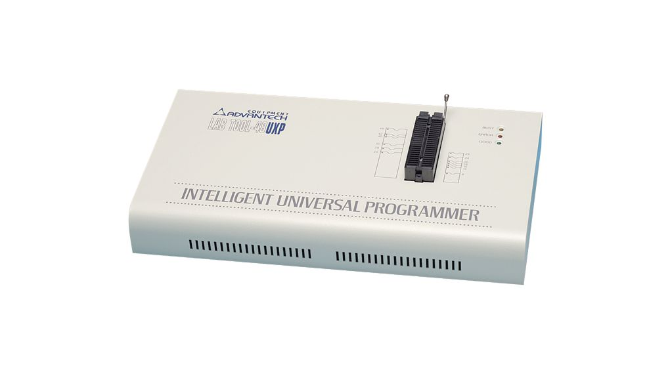
Out-of-Circuit Programming
Its performed outside the target board
Labtool-48UXP

Slide 8
Out-of-Circuit Programming
The processor or memory chip into which the firmware needs to be embedded is taken out of the target board and its programmed with the programming device
The programming device is a dedicated unit which contains the necessary hardware circuits generate the programming signals.
Most of this devices are capable to support different family of devices.
The programmer contains ZIF socket locking pin to hold the device to be programmed.
The programming device is under the control of a utility program running in the PC.
Programmer is interfaced to pc through RS232/USB/Parallel port interface

Slide 9
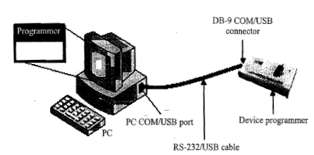
Out-of-Circuit Programming
Interfacing of device programmer with pc

Slide 10
Out-of-Circuit Programming
The sequence of operations for embedded firmware with a programmer is
Connect the programming device to specified port(USB/COM/Parallel port)
Power up the device
Execute the programming utility on the pc and ensure proper connectivity between pc and programmer
Unlock the ZIF socket by turning the lock pin
Insert the device to be programmed into the open socket
Lock ZIP socket

Slide 11
Out-of-Circuit Programming
Select the device name from the list of supported devices
Load the hex file which is to be embedded into the device
Program the device by program option of utility program
Wait till the completion of programming operation
Ensure that programming is successful by checking the status LED on the programmer
Unlock the ZIF socket & take device out of programmer

Slide 12
After doing these operations the firmware is successfully embedded into the device.
Insert the device into the board, power up the board, power up the board and test it for required functionalities.
The ZIF socket supports only Dual Inline Package(DIP)
If security is required, enable the memory protection on the utility before programming the device
Only EEPROM/FLASH memory are erasable

Slide 13
Drawback of Out-of-Circuit Programming
High development time. Whenever changes occurs in the firmware chip should be taken out from the device and programmed. This may cause chip damage due to frequent insertion and removal. A socket can be used at the board side to hold the chip till modification is over.
Programmer allows to program only one chip at a time. Hence not suitable for batch production. Gang programmer resolves this problem.
Very difficult to update firmware after the product is released

Slide 14
In System Programming
Firmware is embedded into the target device without removing it from the target board
The target device must have ISP support.
The requires facilities are board, PC, ISP utility and ISP cable.
Normally serial interface communication and protocols preferred. The protocols used for ISP is Joint Test Action Group(JTAG) or Serial Peripheral Interface (SPI) or any other proprietary protocol.
In order to perform ISP operations, the target device must be in ISP mode.
This mode allows the device to communicate with an external host through serial interface. The device receives commands and data from the host, erases and reprogram the code memory according to the received command.
Once the ISP operations are completed, the device is reconfigured.

Slide 15
In System Programming with SPI protocol
Devices with SPI in System Programming support contains a built in SPI interface and the on chip EEPROM or FLASH memory is programmed through this interface.
The primary I/O lines involved in SPI are
MOSI-Master Out Slave In-program data is sent to the MOSI pin of the target device.
MISO-Master In Slave Out - The device acknowledgement is originated from the MISO pin of the device.
SCK-System Clock – SCK pin acts for the clock for data transfer.
RST-Reset of Target Device -
GND-Ground of Target Device
PC acts as master and target device acts like slave in ISP
A utility program can be developed on the PC to generate these signal lines and these lines are connected to the parallel port of the PC.
The pins of the parallel port to which the ISP pins of the device need to be connected depends on the program else we can fix the lines and then write the program.

Slide 16
Power up sequence of ISP for Atmel’s AT89S series microcontroller
Apply supply voltage b/w VCC and GND pin of target chip
Set RST pin to HIGH
If crystal is not connected across pins XTAL1 and XTAL2,apply 3 to 24 Mhz clock to XLAL1 and wait for 10ms
Enable serial programming by sending the programming enable serial instruction to pin MOSI/P1.5. the frequency of the shift supplied at pin SCK/P1.7 need to be less than the CPU clock at XTAL1 divided by 40.

Slide 17
In System Programming
The code or data array is programmed one byte at a time by supplying the address and data together with the appropriate Write instruction. The selected memory location is first erased before the new data is written
Any memory location is verified by using read instruction, which returns the content at the selected address at serial output MISO/P1.6
After successfully programming the device, set RST to low or turn off the chip power supply and turn it to ON to commence the normal operation

Slide 18
In Application Programming
It’s a technique used by firmware running on the target device for modifying a selected portion of the code memory
It modifies the program code memory under the control of embedded application including updating calibration data, look up tables etc. which are stored in embedded applications.
The Boot ROM resident API instruction which performs various functions such as programming, erasing, reading the flash memory during the ISP mode is made available to the end user written firmware for IAP.
Thus it is possible for an end user application to perform operation on the flash memory.
A common entry point to these API routines is provided for interfacing them to the end users applications.
Functions are performed by setting up specific registers as required by specific operations and performing a call to the common entry point.
after the completion of the code, the function will return to the end users code.

Slide 19
The Boot ROM is shadowed with the user code memory and its address range.
The shadowing is controlled by a status bit.
When this bit is set, access to the internal code memory in this address range is from the Boot ROM.
When this bit is not set access will be from users code memory.

Slide 20
Use of factory Programmed Chip
Here embed the firmware into the target processor/controller memory at the time of chip fabrication itself. Such chips are called factory programmed chip.
Once the firmware design is over and the firmware achieved operational stability, the firmware files can be sent to the chip fabricator to embed it into the code memory
It reduces the product development time.
They are bit expensive
It is not recommended as the firmware goes frequent modifications.

Slide 21
Firmware Loading for OS based devices
Its programmed using ISP technique
OS based system contain a special piece of code called boot loader program which takes control of the OS and application firmware embedding and copying of the OS images to the RAM of the system for execution.
Bootloader comes as preloaded or it can be loaded in to the memory using various interface support like JTAG.
Boot loader contains necessary driver initialization implementation for initializing the support interface like UART,TCP/IP etc
E.g. Load from FLASH ROM, Load from network ,Load through UART etc
In case of network based loading, the bootloader broadcast the target’s presence over the network and the host machine on which the OS image resides can identify the target device capturing the message. Once the communication link is established between the target and host, OS can be directly downloaded into the flash memory of the target device.

Slide 22
EMBEDDED SYSTEM DEVELOPMENT ENVIRONMENT

Slide 23
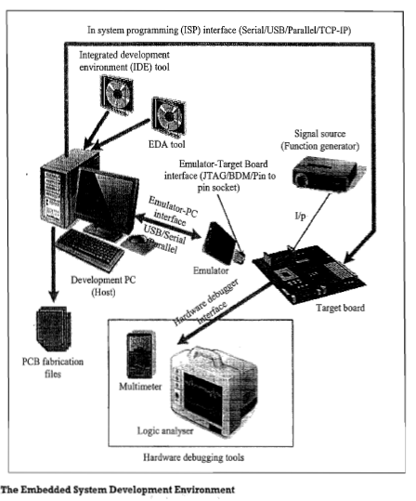

Slide 24
Components of Embedded development environment
Host Computer
Acts as the heart of development environment.
IDE Tools
Tools for firmware design and development
Electronic Design Automation Tools
Embedded Hardware Design
IDE & EDA are selected based on the target hardware.
They are supplied as installable files.
Emulator hardware
Debugging target board

Slide 25
Components of Embedded development environment
Signal Sources (function generator)
Simulates inputs to target board
Target Hardware Debugging tools
CRO(Cathode Ray Oscilloscope), Multimeter ,Logic Analyser
For debugging hardware
Target Hard ware

Slide 26
IDE
In E.S, IDE stands for an integrated environment for developing and debugging the target processor specific embedded firmware
An IDE is also known as integrated design environment or integrated debugging environment.
IDE is a software package which bundles a “Text Editor”, “Cross-compiler”, ”Linker” and a “Debugger”
IDE is a software application that provides facilities to computer programmers for software development. IDEs can either command line based or GUI based
GUI based IDEs are called visual IDE. Eg: visual C++,NetBEans, Eclipse.

Slide 27
Examples.
The IDEs for embedded system development is supplied either by
The target processor/controller manufacturer
Eg: MPLAB supplied by micro chip for PIC family of microcontrollers.
A Third party vendors
Eg. Keil mVision5 from ARMKeil for 8051/ARM microcontrollers
Open source
CodeWarrior for ARM family

Slide 28
IDE Components
1.Text Editor or Source code editor
2.A compiler and an interpreter
3.Build automation tools
4.Debugger
5.Simulators
6.Emulators and logic analyzer
E.g. Turbo C/C++,Microsoft visual c++ etc

Slide 29
Cross Compilation
Cross compilation is the process of converting a source code written in high level language to a target processor/controller understandable machine code
The conversion of the code is done by software running on a processor/controller which is different from the target processor.
The software performing this operation is referred as the Cross-compiler
In other words cross-compilation the process of cross platform software/firmware development.
A cross complier is a compiler that runs on one type of processor architecture but produces object code for a different type of processor architecture.

Slide 30
Cross Compiler-Advantages
By using cross compliers we can not only develop complex E.S , but reliability can be improved and maintenance is easy.
Knowledge of the processor instruction set is not required.
Register allocation and addressing mode details are managed by the compiler.
The ability to combine variable selection with specific operations improves program readability.

Slide 31
Cross Compiler-Advantages cont
Keywords and operational functions that more nearly resemble the human thought process can be changed.
Program development and debugging time will be dramatically reduced when compared to assembly language programming
The library files that are supplied provide may standard routines that may be incorporated into our application.
Existing routine can be reused in new programs by utilizing the modular programming techniques available with C.
The C language is very portable and very popular

Slide 32
Types of Files Generated on Cross compilation
1.List File
2.Pre-processor Output file
3.Hex File (.hex)
4.Map File (File extension linker dependent)
5.Object File (.obj)

Slide 33
1.List Files(.lst files)
Generated at the time of cross compilation
Contain information about cross compilation process like
Cross compiler details
Formatted source text
Assembly code generated from the source file
Symbol table
Errors and warning detected by the cross compiler system
The type of information contained in the list file is cross compiler specific
List file is very useful for application debugging in case of any cross compiler issues.

Slide 34
Sections of List file
PAGE HEADER
A header on each page of the listing file which indicates the compiler version number, source file name, date, time and page number.
Eg: C51 COMPILER V9.53.0.0 SAMPLE 10/16/2014 15:47:10 PAGE 1
Command Line
Represents the entire command line that was used for invoking the compiler.
Source code
Outputs the line number along with the source code on that line.
Special cross compiler directives can be used to include or exclude the conditional codes.
It also contains comments and include files.
Special cross compiler commands can also be included to add all the lines of include file`

Slide 35
Assembly Listing
Contains assembly code generated
Symbol Listing
Contains symbolic information about the various symbols present in the cross compiled source file.
It contains symbol name, symbol classification, memory space, data type, offset and size in bytes.
Symbol listing in the list file presentation can turn on or off by cross compiler.
Module Information
It provides the size of initialized and un initialized memory areas defined by the source file.
Warning and errors
Records the errors encountered or any statement that may create issues in application during cross compilations.

Slide 36
2. Preprocessor output file
Generated during cross compilation
Contain preprocessor output for the preprocessor instructions used in the source file
This file is used for verifying the operation of macros and conditional preprocessor directives
Is a valid C file
File extension is cross compiler dependant

Slide 37
3. Object files(.obj files)
It is the lowest level file format for any platform.
Cross compiling each source module converts the various Embedded instructions and other directives present in the module to an object(.OBJ) file.
The object file is specially formatted file with data records for symbolic information, object code, debugging information etc.

Slide 38
Object files cont..
OMF1 & OMF2 are the 2 object files supported by C51 Cross compiler
List of details included in object file are
Reserved memory for global variables
Public symbol(variable or function )names
External symbol(variable or function )references
Library files with which to link
Debugging information to help synchronize source lines with object code
The object code present in the object file is not absolute
It is the responsibility of the linker or loader to assign absolute memory locations to the object code.

Slide 39
4.Map Files
Object file created contains re-locatable codes where their location in memory is not fixed
It is the responsibility of linker to link these object modules
The locator is responsible for locating the absolute address to each module in the code memory
Map files are generated by the linker and loader.
It is also called linker list files.
These files are used to keep the information of linking and locating process.
Map files use extensions .H,.HH,.HM depends on linker or loader

Slide 40
Sections of map files
Page Header
Indicates linker version number, name, date, time and page number
Command line
Represent the command line that used to invoke the linker
CPU details
Contains the details about target CPU and memory model.
Input modules
This section includes the names of all object modules, library files and modules that are in linking process.
Memory map
Lists the starting address, length, relocation types and name of each segment in the program

Slide 41
Symbol table
It contains the value, type and name for all symbols from the different input modules
Inter module cross reference
It includes the session name, memory type and the name of the module in which it is defined and all modules in which it is accessed.
Program size
Contains the size of various memory areas as well as constant and code space for the entire application.
Warning and errors
Contains errors and warnings generated while linking the program.

Slide 42
5. Hex file
It is binary executable file created from the source code.
The absolute object file created by the linker or loader is converted into processor understandable binary code.
The utility used to convert an object file to hex file is known as Object to Hex file converter.
Hex file embed machine code in a particular format.
Format of Hex files varies across the family of processor.
Eg: Intel Hex File, Motorola Hex File

Slide 43
The lines in intel Hex files are corresponding to a Hex Record
Each record is made up of hexadecimal numbers that represent machine language code or constant data
Individual records are terminated with a carriage return and a line feed
It is used for transferring a program and data to a ROM or EEPROM which is used as code memory storage.

Slide 44
Intel Hex Files
Intel HEX file is composed of a number of Hex records
Each record is made up of five fields
Eg: :llaaaattdd…cc
Each group of letters corresponds to a different field.
Each letter represents a single hexadecimal digits
Each field is composed of two hexadecimal digits.

Slide 45
Field | Description
: | Start of every Intel Hex record
ll: | Record length field. Indicates the number of data bytes in the record.
aaaa: | Represents the starting address of subsequent data in the record.
tt: | Indicates HEX record type 00: Data Record 01:End of File Record 02: 8086 segment address record 04: extended linear address record
dd: | Data field that represents one byte of data. A record can have number of data bytes which should be represented in this field.
cc: | checksum

Slide 46
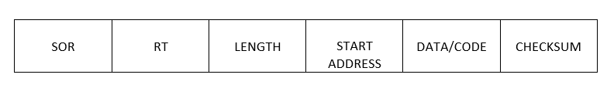
Motorola Hex File format
Represented as ASCII text file.
It represents a HEX Record.
It is made up of hexadecimal numbers
The format of record is

Slide 47
FILED | DESCRIPTION
SOR | Stands for Start of Record. The ASCII character S is used as the Start of Record. Every record begin with character ‘S’
RT | Stands for Record Type. T represents the type of record. There are 4 different types of record. 0: Header. Indicates the beginning of HEX file. 1: Data record with 16bit address 2: Data record with 24bit address 9:End of File Record.
Length(ll): | Count of character pair in the record, excluding the type and record length. Each ‘l’ re[rent a number between 0 to 9 and A to F
Strat address(aaaa): | Representing starting address for the subsequent data
Code/data (dd): | Data field that represents one byte of data
Checksum | Checksum of record.

Slide 48
Disassembler/Decompiler
Both are reverse engineering tools
Reverse engineering is a technology used to reveal the technology behind the working of a product
Used to find out the secret behind popular proprietary product
Helps the reverse engineering process by translating embedded firmware to assembly /high level instruction
Powerful tools are available for analyzing the presence of malicious contents
The exact code is not available. But some what similar code is obtained.

Slide 49
DISASSEMBLER
Utility program that convert machine code into assembly code
The process of converting machine code into assembly code is called disassembling.
It is complementary to assembling or cross assembling

Slide 50
DECOMPILER
Is a utility program that convert machine language instruction to high level language instruction
For different processors different decompilers are available.
Performs reverse operation of compiler or cross compiler

Slide 51
Simulators, Emulators and debugging
SIMULATORS
Simulator is a software tool for simulating various functionality of the application software
IDE provides simulator support
Simulator simulates target hardware and firmware execution can be inspected using simulators.

Slide 52
Features of simulator based debugging
Purely software based
Doesn’t require a real target system
Very primitive (Lack of featured I/O support.)
Lack of real time behavior

Slide 53
Advantage of simulator based debugging
No need of target board
Purely software oriented , IDE simulates the target board
Since real hardware is not needed we can start immediately after the device interface and memory maps are finalized this saved development time
User needs to know only the memory mapping of various devices with target board.
After the device interface and memory map the developer can start programming
Simulated I/O peripherals
It provides an option to simulate various input output devices.
Using simulators input output support we can edit the values for I/O registers and can be used as input/output values in firmware execution.
It eliminates the need for connecting I/O devices for debugging the firmware.
Simulates abnormal conditions
Can input any parameter as input during debugging hence can check for abnormal conditions easily
Helps the developer to study the abnormal behavior of the firmware under abnormal input conditions.

Slide 54
Limitations of Simulator based debugging
Deviation from real behaviour:
Simulation based debugging is carried out in an environment where the developer may not be able to debug the firmware under all possible combinations of input.
Under certain conditions we get some particular output which need not be same when the firmware runs in a production environment.
Lack of real timeliness:
The debugging is developer driven and cannot produce real time behaviour.
In real time the input conditions may vary.

Slide 55
Debugging
It is the process of diagnosing the firmware execution, monitoring the target processors registers and memory while the firmware is running.
It also checks the signals from various embedded hardware.
Two types of debugging
Hardware debugging:
deals with monitoring of various bus signals
Checking the status lines of target hardware.
Firmware debugging
Deals with examining the firmware execution, execution flow, changes to various CPU registers and status registers on execution of the firmware to ensure that the firmware is running as per design.

Slide 56
Firmware debugging
Performed to figure out the bug or the error in the firmware which creates unexpected behaviour.
The main firmware debugging techniques are
Incremental EEPROM burning technique
Inline breakpoint based Firmware debugging
Monitor program based Firmware debugging
In Circuit Emulator based Firmware debugging

Slide 57
Incremental EEPROM burning technique
Most primitive type of firmware debugging technique.
In this code is separated into different functional code units.
Code is burnt in incremental order.
The code corresponding to all functionalities are separately coded, cross-compiled and burned into the chip one by one.
If the first functionality is working well, go for the next and so on.
If all functionalities are working well combine the code for all functionalities, recompile and burn the code for the total system functioning.

Slide 58
Advantages and disadvantages
Advantages
Once the testing is completed production can start.
Useful in small, simple systems
Useful when no debugging tools are available
Disadvantages
Time consuming

Slide 59
Inline breakpoint based firmware debugging
Within the firmware where you want to ensure that the firmware execution is reaching up to a specified point, insert an inline debug code immediately after the point
It is a print() function where you insert a string to ensure firmware execution covering that point.
Cross compile this code
We can see the debug information in the terminal program

Slide 60
Monitor Program based firmware debugging
In this method a monitor program which acts as a supervisor is developed.
The monitor program controls the downloading of the source code into the code memory, inspects or modify the register/ memory locations, allows stepping of source code etc.
The monitor program implements debug functions as per pre defined command set from the debug application interface.
The monitor program always listen to the serial port of the target device and according to the command received from the serial port it performs actions.
The monitor program will handle the command reception from the serial interface.

Slide 61
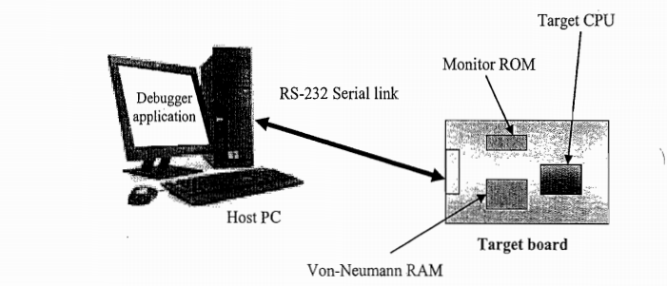
The entire code stuff handling the command reception and the corresponding action implementation is known as monitor program.
After the successful completion of the monitor program, it is compiled and burned into FLASH memory or ROM of the target board.
The code memory containing the monitor program is called ‘Monitor ROM’

Slide 62
Minimum features of a monitor program
Command set interface to establish communication with debugger application
Firmware download option to code memory
Examine and modify processor register and working memory(RAM)
Single step program execution
Set beak point in firmware execution
Send debug information to debug application running on the host machine.

Slide 63
Drawbacks
In monitor based debugging shrinks the total available memory into Von-Neumann memory and it needs to accommodate all kinds of memory requirement.
The serial port of the target processor is dedicated for the monitor applications and it cannot be used for any other device interfacing. Hence wastage of serial port.

Slide 64
Comparison between simulator and Emulator
Simulator | Emulator
A software application which duplicates the functionality of the features and instructions supported by target CPU. | Self contained hardware device which emulates the target CPU. It contains emulation logic, hooked into the debugging application running on the development PC on one end and connect through target board through some interface on the other end.
Simulates target board | Emulates target board

Slide 65
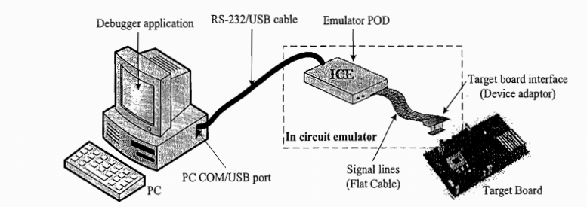
In Circuit Emulator based Firmware debugging

Slide 66
Emulation Device
It is a replica of the target CPU which receives various signal from the target board through a device adaptor connected to the target board and performs the execution of firmware under the control of debug command from the debug application.
It may be a standard chip or a programmable Logic Device configured to function as the target CPU.
If a standard chip is used it will provide real time behaviour. But cannot be used for any other device.
PLD based chip can be easily reprogrammed to suit any other device of the same type.
PLD based emulators are simple to implement for simple CPU., but accuracy is an issue in the replication of target functionalities.

Slide 67
Emulation Memory
It is the random access memory incorporated in the emulator device.
It acts as a replacement of EEPROM where code memory is copied.
It is called ROM Emulation.
It eliminates the problems of ROM burning and helps for infinite number of re programming.
It also acts as a trace buffer which stores instruction executed or registers modified or related data by the processor.

Slide 68
Common features of trace buffer memory
Records each bus cycle in a frame.
Trace data can be viewed in the debugger application as Assembler or source code.
Trace buffering can be done on the basis of a trace trigger
It can record signals from the target board other then CPU signals.
Trace data is very useful information in firmware debugging

Slide 69
Emulator Control Logic
Logic circuit used for implementing complex hardware breakpoints, trace buffer trigger detection, trace buffer control etc.
Used for implementing logic analyser functions.

Slide 70
Device Adaptors
Act as an interface between the target board and emulator POD.
They are pin-to pin compatible sockets.
Connected using ribbon cables.

Slide 71
Types of emulators
Debug Board Modules
Combines emulation control logic and emulation device in a single board.
Base terminal and probe card
This type supports a variety of processors.
Base terminal contains emulator hardware and control logic.
Base terminal is connected with development PC.
Emulation chip is mounted on a separate PCB and connected to the base terminal through a ribbon cable.
Probe card board contains device adaptor sockets to plug the board into the target development board.
Board containing emulation chip is the probe card.
Probe card is different for different CPUs

Slide 72
On chip firmware debugging
They are built in debugging modules.
They supports fast and efficient firmware debugging.
Processor with OCD support incorporates a dedicated debugging module with existing architecture.
OCD provides means to support simple breakpoint, query internal state of chip, and step through code.
Dedicated registers are provided for debugging support.
Debugging can be enabled using OCD enabled bit.
Some hardware logic is implemented between CPU OCD and host PC to capture the debugging information.

Slide 73
BDM
Background debugging module is a proprietary on chip debug solution from Motorola
It uses 10-26 pin connector to connect the target board.
Serial Data in (SDI)
Serial Data Out(SDO)
Serial clock are three important pins

Slide 74
Thank You

